Slide 1

Lecture 2: Containers
AC295
AC295
Advanced Practical Data Science
Pavlos Protopapas

Slide 2
Outline
1: Class organization
2: Recap
3: Software Development
4: Containers
5: Hands On

Slide 3
Class organization
Group formation
Presentation schedule
Review class flow

Slide 4
Outline
1: Class organization
2: Recap
3: Software Development
4: Containers
5: Hands On

Slide 5
Why should we use virtual environment?
What could go wrong? Unfortunately, Maggie and John reproduce different results and they think the issue relates to their operating systems. Indeed while Maggie has a MacOS, John uses a Win10.
lib1
lib2
lib3
lib1
lib2
lib3
lib1
lib2
lib3
bins
bins
bins
lib1
lib2
lib3
env_ac295
env_ac295
env_am207
bins
Operating System (MacOs)
Operating System (Win10)
Maggie
John

Slide 6
Virtual environments
Pros
Reproducible research
Explicit dependencies
Improved engineering collaboration
Broader skill set
Cons
Difficulty setting up your environment
Not isolation
Does not work across different OS

Slide 7
Virtual Machines Limitations
Uses hardware in your local machine (cannot run more than two on an average laptop)
There is overhead associated with virtual machines
guest is not as fast as the host system
Takes long time to start up
may not have the same graphics capabilities

Slide 8
Outline
1:Class organization
2: Recap
3: Software Development
4: Containers
5: Hands On

Slide 9
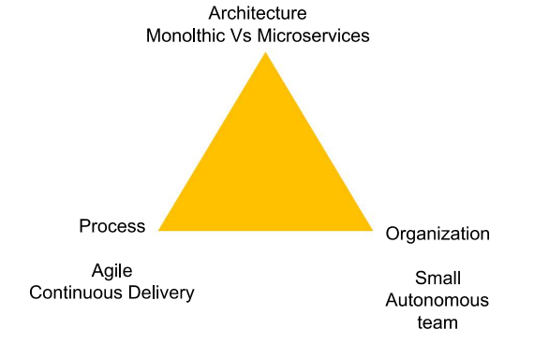

Successful Software Application
Imagine you are building a large complex application (e.g. Online Store)

Slide 10
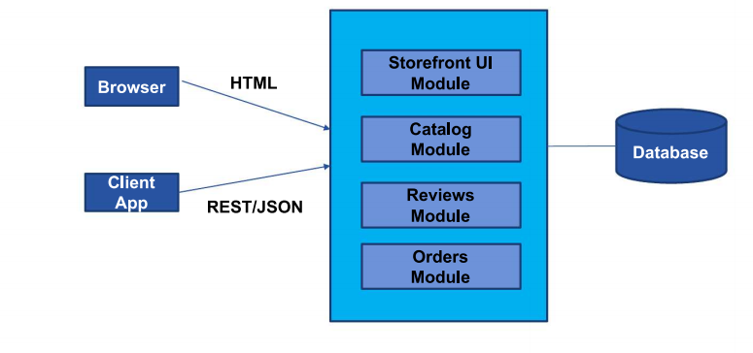
Monolithic Architecture

Slide 11
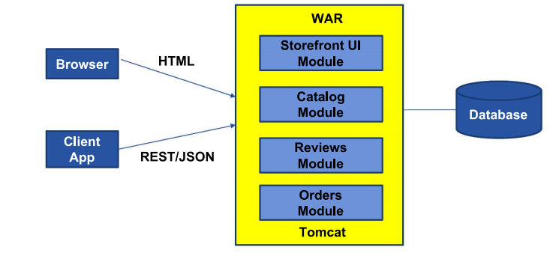
Monolithic Architecture

Slide 12
Benefits of Monolith
Simple to Develop, Test, Deploy and Scale:
Simple to develop because of all the tools and IDEs support to that kind of application by default
Easy to deploy because all components are packed into one bundle
Easy to scale the whole application

Slide 13
Disadvantages of Monolith
Very difficult to maintain
One component failure will cause the whole system to fail
Very difficult to create the patches for monolithic architecture
Adapting to new technologies is challenging
Take a long time to startup because all the components needs to get started

Slide 14
Applications have changed drammatically
A decade ago
Apps were monolithic
Built on a single stack (e.e. .NET or Java)
Long lived
Deployed to a single server
Today
Apps are constantly developed
Built from loosely coupled components
Newer version are deployed often
Deployed to a multitude of servers

Slide 15
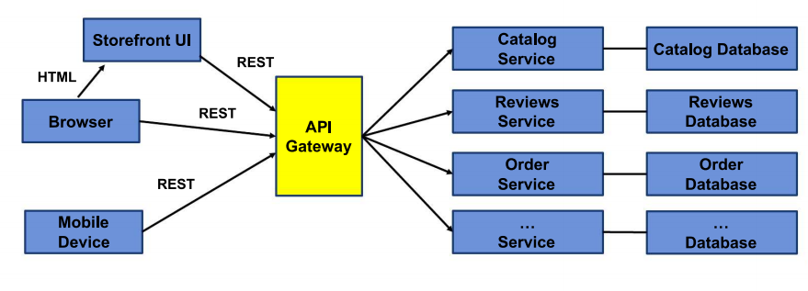
Microservice Architecture

Slide 16
Outline
1: Class organization
2: Recap
3: Software Development
4: Containers
5: Hands On

Slide 17
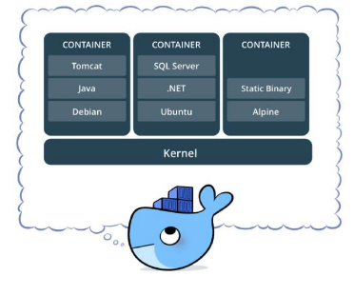
What is docker
Standardized packaging for software dependencies
Isolate apps from each other
Share the same OS kernel
Works for all major Linux distributions

Slide 18
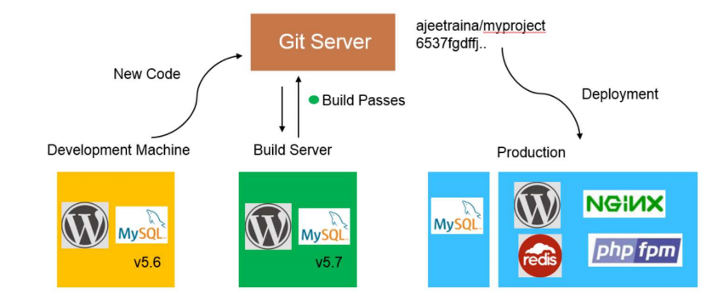
Traditional Software Development Workflow (without Docker)

Slide 19
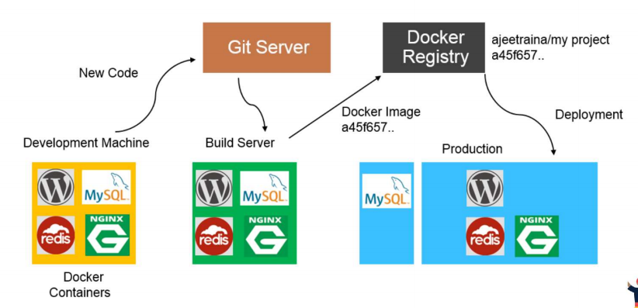
Traditional Software Development Workflow (with Docker)

Slide 20
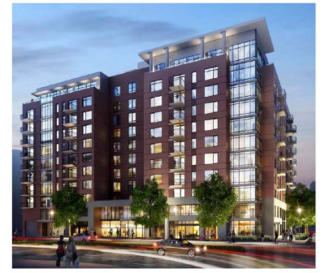
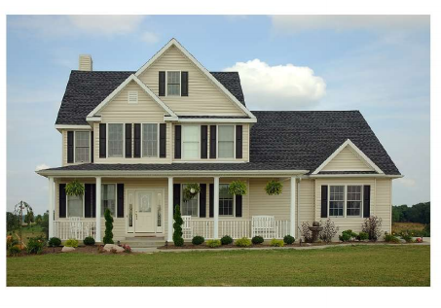
Docker Containers are not Virtual Machines
Virtual Machines Containers

Slide 21
Docker Container vs Virtual Machines (VM)
VMs
Each VM runs its own OS
Boot up time is in minutes
VMs snapshot are used sparingly
Not effective diffs. Not version controlled
Cannot run more than couple of VMs on an average laptop
Only one VM can be started from one set of VMX and VMDK files
Docker
Container is just a user space of OS
Containers instantiate in seconds
Images are built incrementally on top of another like layers. Lots of images/snapshots
Images can be diffed and can be version controlled. Docker hub is like Github
Can run many Dockers in a laptop
Multiple docker containers can be started from one Docker image

Slide 22
Docker Container vs Virtual Machines
App1
App2
App3
App1
App2
App3
Bins/lib
Bins/lib
Bins/lib
Guest
OS
Guest
OS
Guest
OS
Bins/lib
Bins/lib
Bins/lib
Container Engine
Hypervisor
Hypervisor
Infrastructure
Infrastructure
Containers
Machine Virtualization

Slide 23
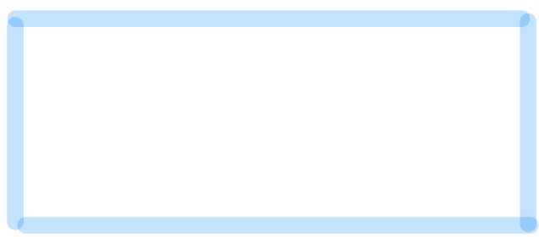
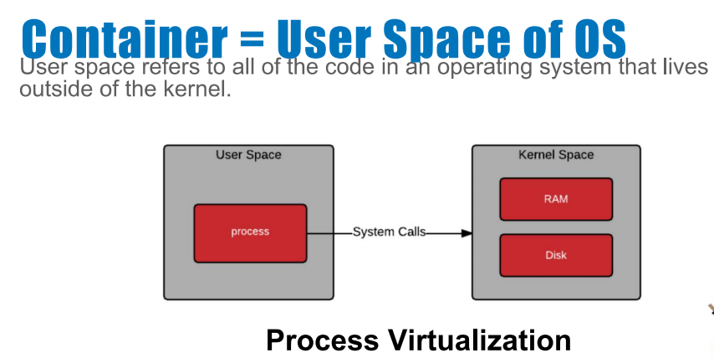
What Makes Containers so Small?
Container = User Space of OS
User space refers to all of the code in an operating system that lives outside of the kernel

Slide 24
Why should we use containers?
It has the best of the two worlds because it allows:
to create isolate environment using the preferred operating system
to run different operating system without sharing hardware
The advantage of using containers is that they only virtualize the operating system and do not require dedicated piece of hardware because they share the same kernel of the hosting system.
Containers give the impression of a separate operating system however, since they're sharing the kernel, they are much cheaper than a virtual machine.
App
App
Libraries
Libraries
App
App
Libraries
Libraries
Kernel
Containers

Slide 25
Why should we use containers? (cont)
With container images, we confine the application code, its runtime, and all its dependencies in a pre-defined format.
With the same image, you can reproduce as many containers as you wish. Think about the image as the recipe, and the container as the cake ;-) you can make as many cakes as you’d like with a given recipe.
A container orchestrator (see next lecture) is a single controller/management unit that connects multiple nodes together.
You can create a container on a Window but install an image of a Linux OS inside that container. The container still works on the Window
App
App
Libraries
Libraries
App
App
Libraries
Libraries
Kernel
Containers

Slide 26
Why should we use containers? (cont)
Containers are application-centric methods to deliver high-performing, scalable applications on any infrastructure of your choice
Containers are best suited to deliver microservices by providing portable, isolated virtual environments for applications to run without interference from other running applications
Containers run container images, it bundles the application along with its runtime and dependencies
Because they're so lightweight, you can have many containers running at once on your system.
App
App
Libraries
Libraries
App
App
Libraries
Libraries
Kernel
Containers

Slide 27
Why containers recap?
Their startup time is on the order of seconds (vs. minutes for Virtual Machines).
They provide pseudo-isolation. This means they're still pretty secure, but not as secure at a Virtual Machines.
A container is deployed from the container image offering an isolated executable environment for the application.
Containers can be deployed from a specific image on many platforms, such as workstations, Virtual Machines, public cloud, etc.
Containers are extremely popular, and their popularity is growing.
One of the first widely used containers was provided by Docker.
Docker containers can be used to run websites and web applications.
Multiple containers can be managed by a service called Kubernetes (see next lecture)

Slide 28
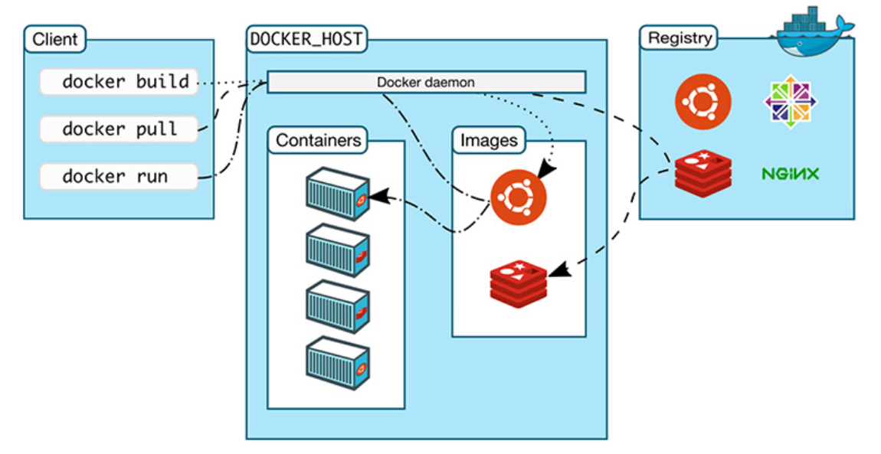
The Docker Engine Architecture
The client allows to run various Docker commands (installed in any OS).
The registry is place to find and download Docker images.
The docker host is the server running the Docker daemon.
https://nickjanetakis.com/blog/understanding-how-the-docker-daemon-and-docker-cli-work-together

Slide 29
Some Docker Vocabulary
Docker Image
The basis of a Docker container. Represent a full application
Docker Container
The standard unit in which the application service resides and executes
Docker Engine
Creates, ships and runs Docker containers deployable on a physical or virtual, host locally, in a datacenter or cloud service provider
Registry Service (Docker Hub or Docker Trusted Registry)
Cloud or server-based storage and distribution service for your images
Images
How you store your application
Containers
How you run your application

Slide 30
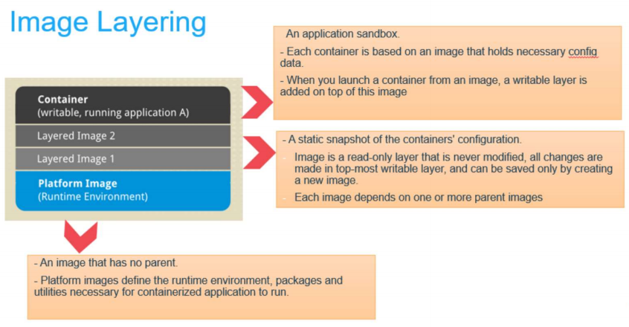
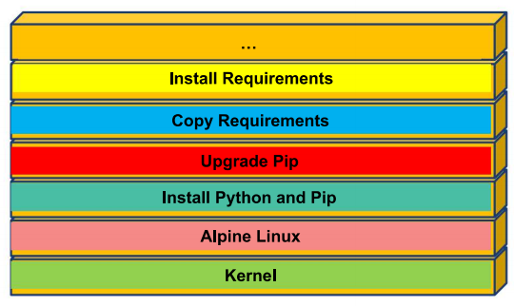
Image Layering

Slide 31
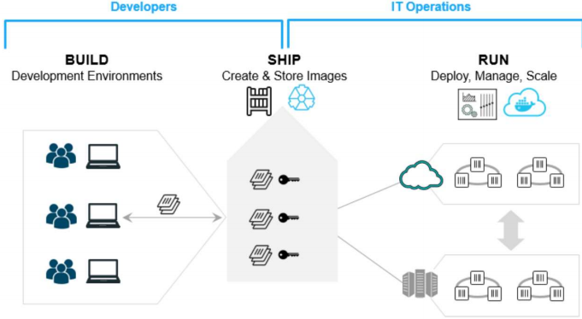
Using Docker – Build Ship and Run Workflow

Slide 32
Outline
1: Class organization
2: Recap
3: Software Development
4: Containers
5: Hands On

Slide 33
Hands on Containers
Exercise set up
Exercise 1: Pull, modify, and push a Docker image from DockerHub
Exercise 2: Build a Docker Image and push it to DockerHub

Slide 34


Exercise 1: pull, modify, and push an image
CLIENT
DOCKER HOST
REGISTRY
docker pull
Docker daemon
docker run
Containers
Images
docker push
https://nickjanetakis.com/blog/understanding-how-the-docker-daemon-and-docker-cli-work-together

Slide 35
Exercise 2: build a Docker Image
CLIENT
DOCKER HOST
REGISTRY
docker build
Docker daemon
Containers
Images
https://nickjanetakis.com/blog/understanding-how-the-docker-daemon-and-docker-cli-work-together

Slide 36
Hands on Containers | Instructions
Exercise set up
install docker (https://hub.docker.com/)
have docker up and running
create a class repository in docker hub (yourhubusername/ac295_playground)
Exercise 1: modify images from Docker Hub
Step 1 | pull image pavlosprotopapas/ac295_l2:latest
Step 2 | run container in interactive mode (-it)
Step 3 | open README file and follow instructions to modify image
Step 4 | push modified image (pavlosprotopapas/ac295_l2)
Exercise 2: Docker Do It Yourself
Step 1 | pull course repository and cd to lecture2/exercises/exercise1
Step 2 | build an image using Dockerfile (for MacOs)
Step 3 | push image to docker hub (yourhubusername/ac295_playground)

Slide 37
THANK YOU
AC295
Advanced Practical Data Science
Pavlos Protopapas

